Slide 1
Image analysis code overview
Miguel Pardo & José Contreras

Slide 2
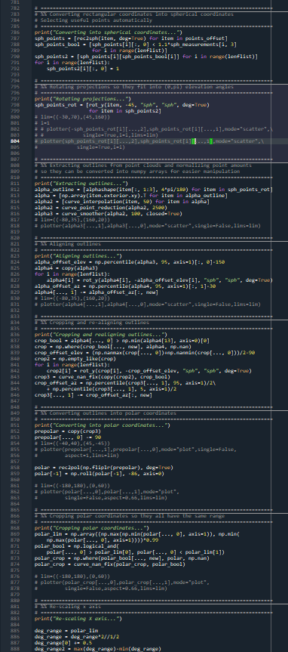
Features
Multiprocess
~2-3 minutes instead of ~15 minutes
Modular

Slide 3
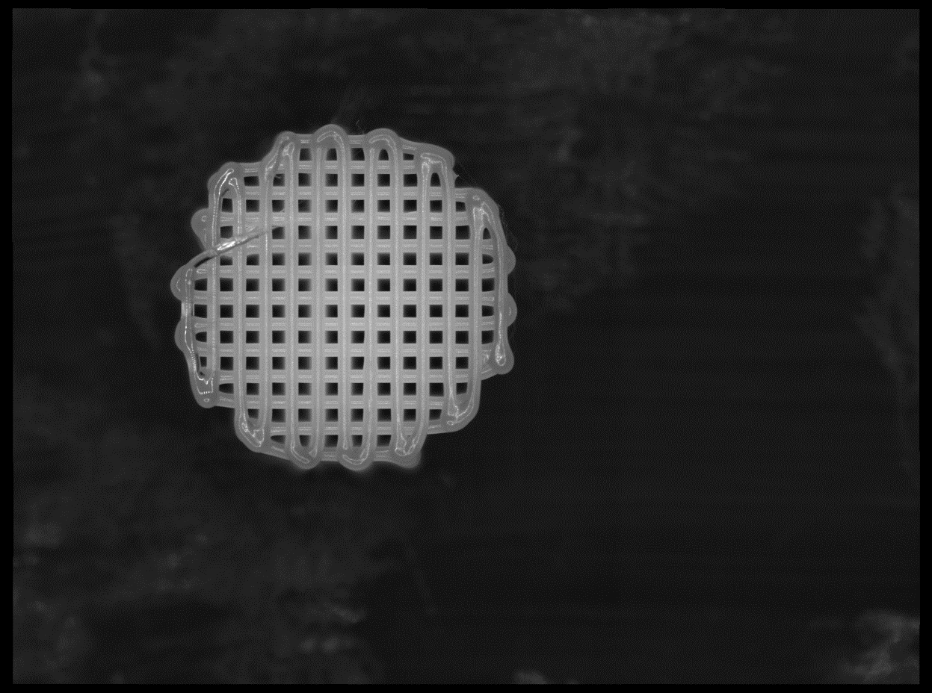
A. Loading and initialization
Load images
Identify tags
Ask user to select ROI if necessary
Automatically calculate printing direction of layers
Correct local brightness differences

Slide 4
A. Loading and initialization
Load images
Identify tags
Ask user to select ROI if necessary
Automatically calculate printing direction of layers
Correct local brightness differences
C:\bioplotter\
PCL Acetone\
110\cojo_cylinder1\R

Slide 5
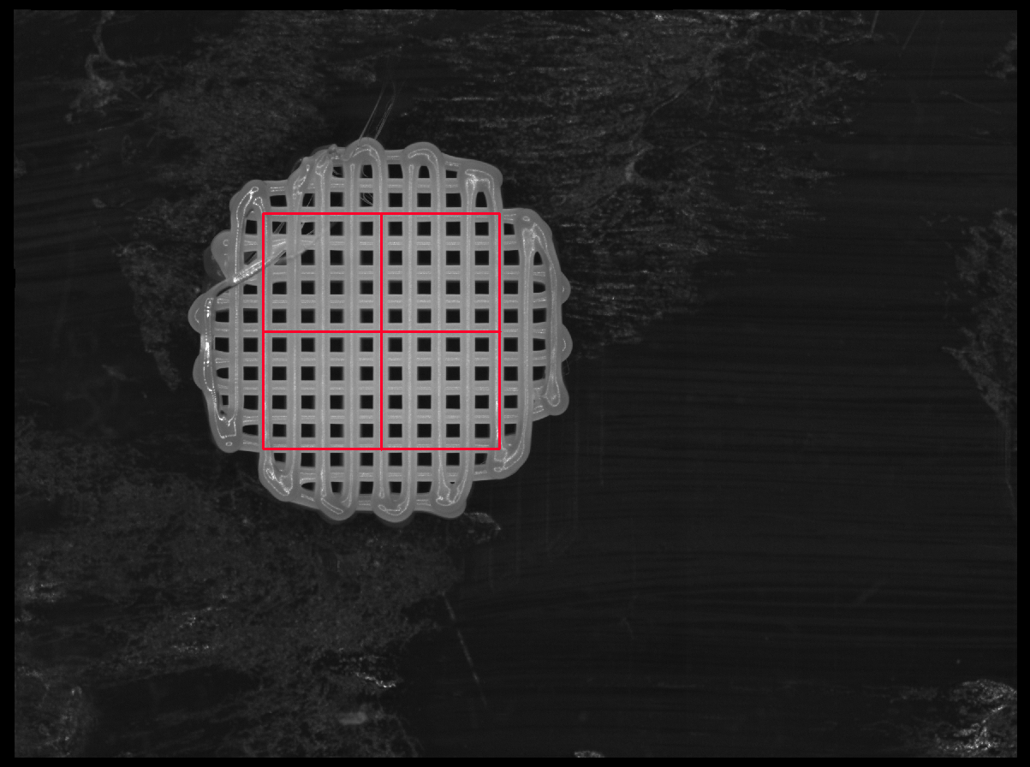
A. Loading and initialization
Load images
Identify tags
Ask user to select ROI if necessary
Automatically calculate printing direction of layers
Correct local brightness differences

Slide 6
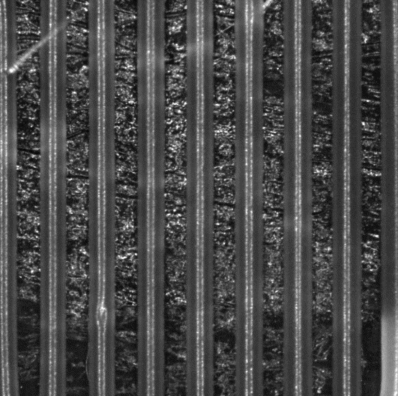
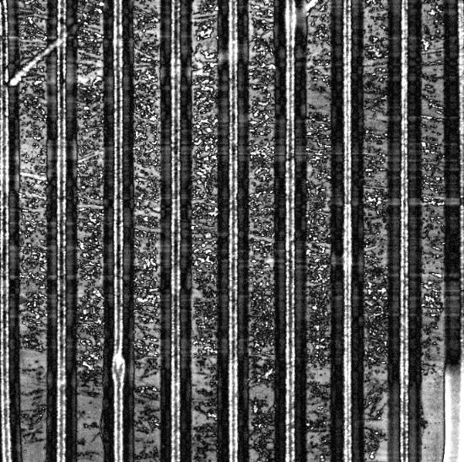
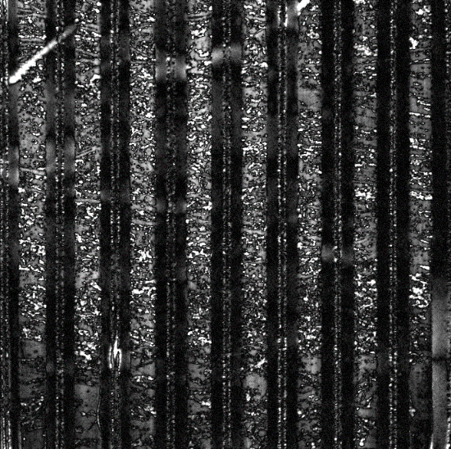
A. Loading and initialization
Load images
Identify tags
Ask user to select ROI if necessary
Automatically calculate printing direction of layers
Correct local brightness differences
Process:
Compare first layer against its horizontally/vertically blurred difference. Darkest overall image corresponds to printing direction
vs

Slide 7
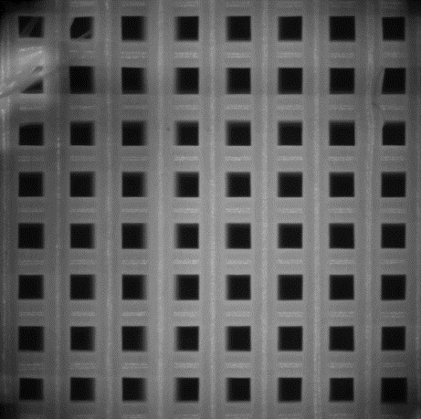
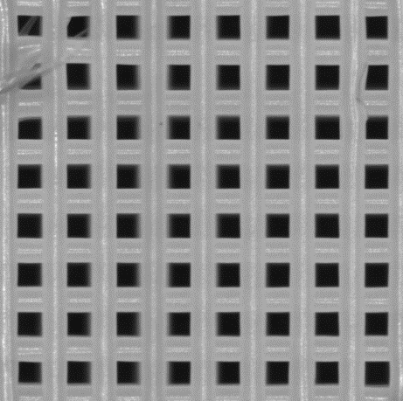
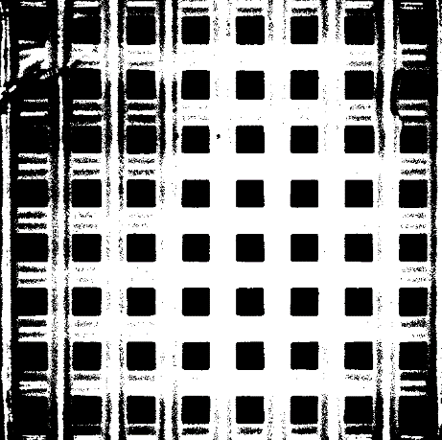
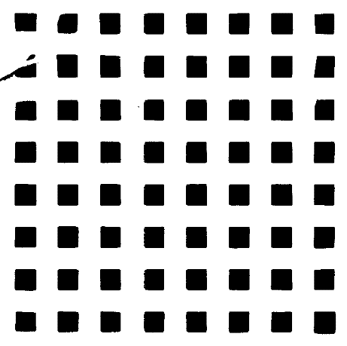
A. Loading and initialization
*effect exagerated
Load images
Identify tags
Ask user to select ROI if necessary
Automatically calculate printing direction of layers
Correct local brightness differences
Process:
Divide input image with a 1-pore (~85 px) blurred and normalized version of itself
Without correction
With
correction

Slide 8
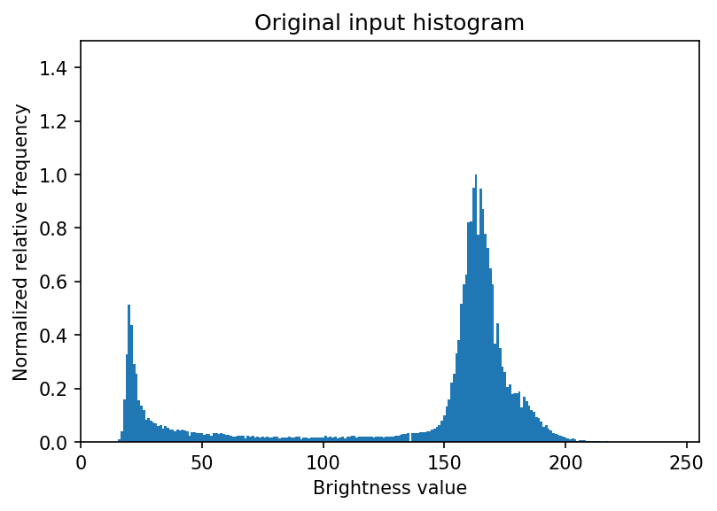
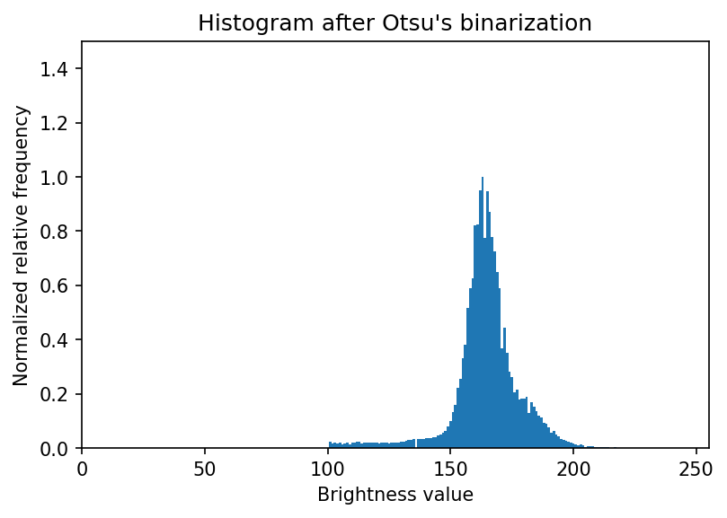
B. Histogram calculation
Calculate and mask images with Otsu’s algorithm
Calculate, smooth and remove floor on new histogram
Differentiate resulting histogram and clip to positive values
Select rising edge of final histogram

Slide 9
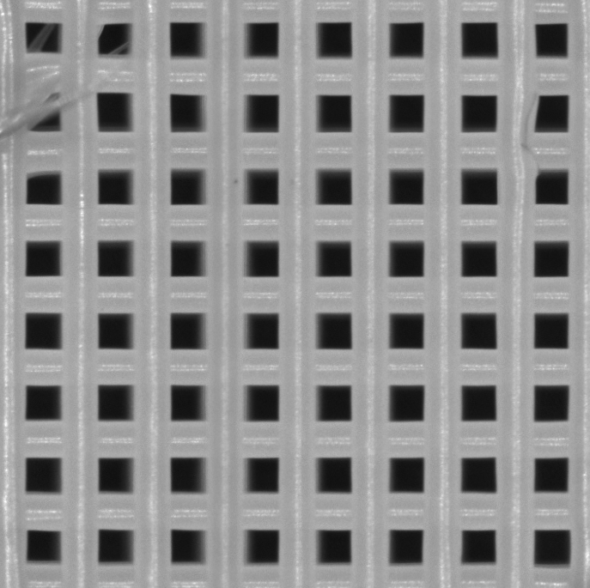
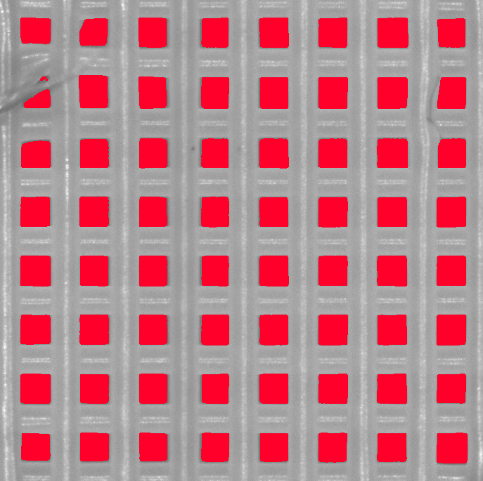
B. Histogram calculation
Calculate and mask images with Otsu’s algorithm
Calculate, smooth and remove floor on new histogram
Differentiate resulting histogram and clip to positive values
Select rising edge of final histogram

Slide 10
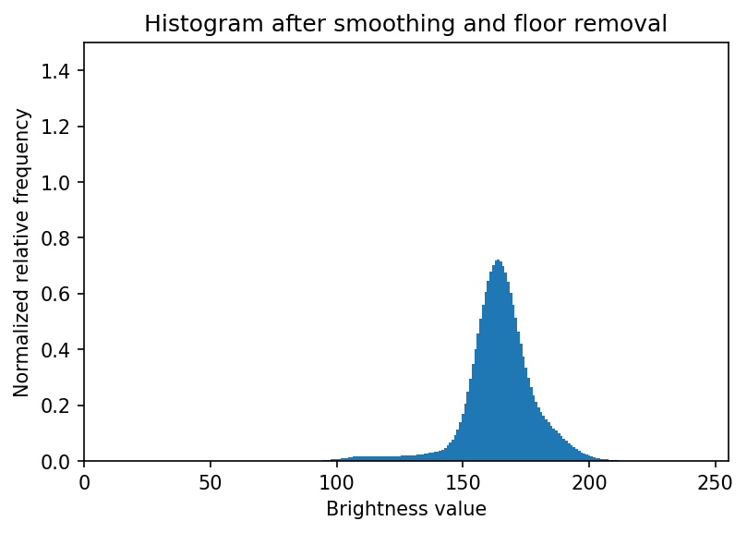
B. Histogram calculation
Calculate and mask images with Otsu’s algorithm
Calculate, smooth and remove floor on new histogram
Differentiate resulting histogram and clip to positive values
Select rising edge of final histogram

Slide 11
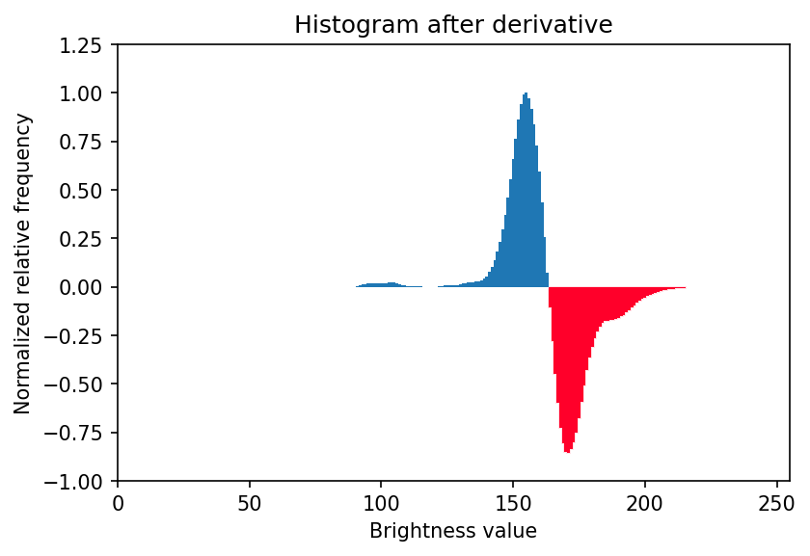
B. Histogram calculation
Calculate and mask images with Otsu’s algorithm
Calculate, smooth and remove floor on new histogram
Differentiate resulting histogram and clip to positive values
Select rising edge of final histogram

Slide 12
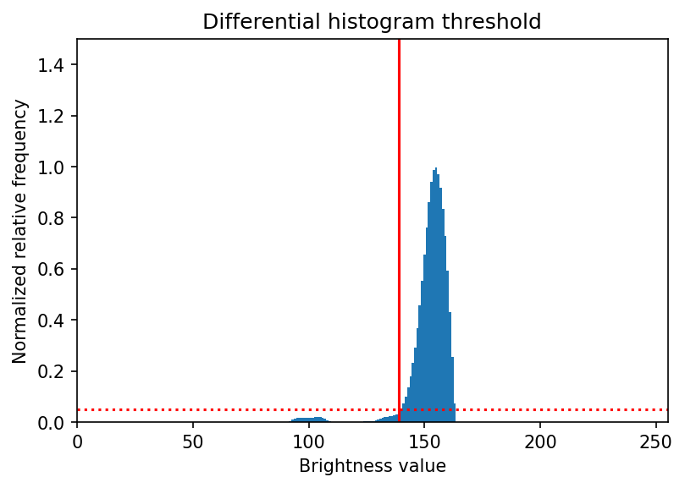
B. Histogram calculation
Calculate and mask images with Otsu’s algorithm
Calculate, smooth and remove floor on new histogram
Differentiate resulting histogram and clip to positive values
Select rising edge of final histogram

Slide 13
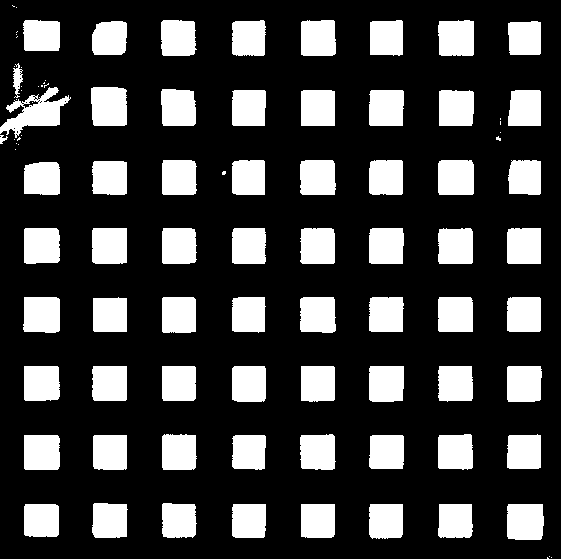
C. Binarization and ROI-checking
Apply calculated threshold and invert image
Create containing grid mask
Check for edge pores
Process binarizated images

Slide 14
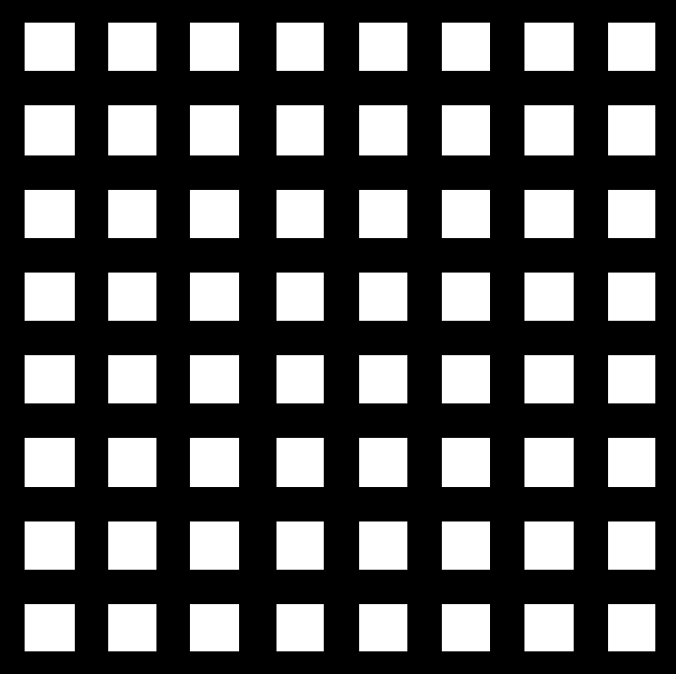
C. Binarization and ROI-checking
Apply calculated threshold and invert image
Create containing grid mask
Check for edge pores
Process binarizated images

Slide 15
C. Binarization and ROI-checking
Create containing grid mask
Creating this grid mask serves a twofold purpose:
It gives out a container contour that will be analyzed in an orderly fashion
It is less sensitive to defects on printing, so it is posible to count how many pores should be on the image

Slide 16


C. Binarization and ROI-checking
Create containing grid mask
Process:
Sum all of the pixels on the threshold image vertically and horizontally
Select a threshold to remove noise
Scale the result back to the original dimesions
Multiply the horizontal and vertical results together

Slide 17
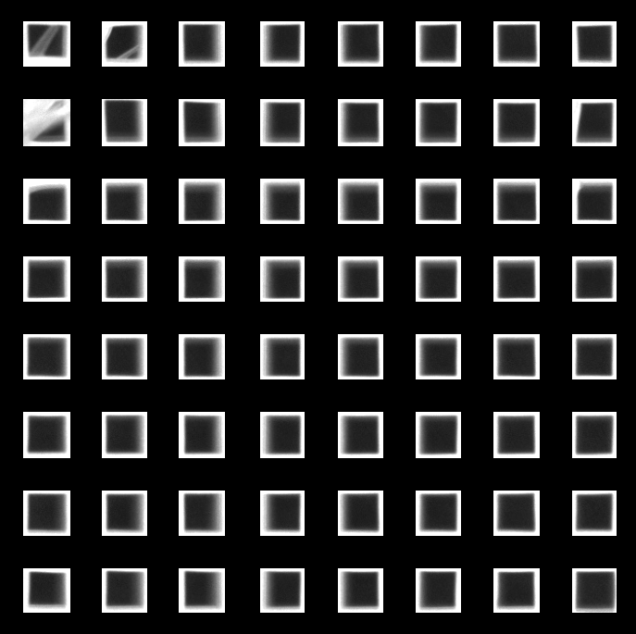
C. Binarization and ROI-checking
Apply calculated threshold and invert image
Create containing grid mask
Check for edge pores
Process binarizated images
The grid has been deliberately made larger than the actual pores, so we don’t lose edge information.

Slide 18
C. Binarization and ROI-checking
Apply calculated threshold and invert image
Create containing grid mask
Check for edge pores
Process binarizated images
If a pore is touching the edge of the grid mask, a new ROI will be recalculated automatically. If after this step there are still any edge pores remaining, the analysis will be rescheduled to run again after a new manual ROI when the current run is finished

Slide 19
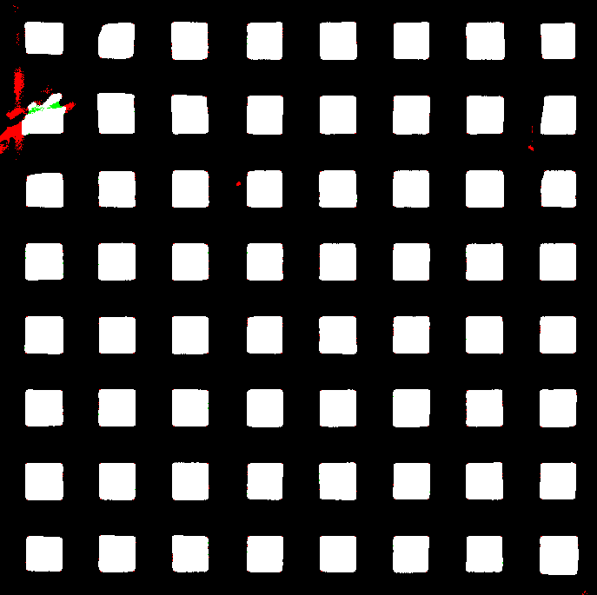
C. Binarization and ROI-checking
Apply calculated threshold and invert image
Create containing grid mask
Check for edge pores
Process binarizated images
The binarized images are processed morphologically to remove unwanted thin inclusions and add back missing parts
Red: deleted areas
Green: added areas

Slide 20
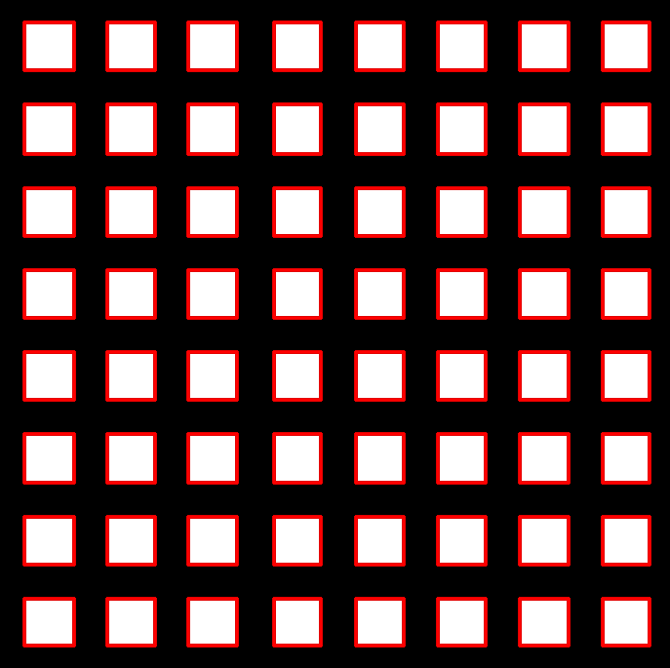
D. Contour detection and error-checking
Find contours of each pore on the grid mask
Check for square and even pore input on grid mask (eg: 8x8 pores, not 6x7 or 7x7)
Find contours of each pore on the binarized image set
Check for missing or split edges and mark them as invalid

Slide 21
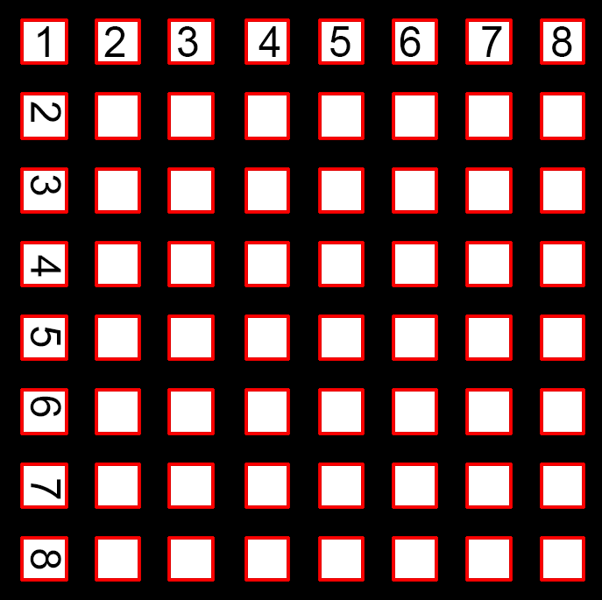
D. Contour detection and error-checking
Find contours of each pore on the grid mask
Check for square and even pore input on grid mask (eg: 8x8 pores, not 6x7 or 7x7)
Find contours of each pore on the binarized image set
Check for missing or split edges and mark them as invalid

Slide 22
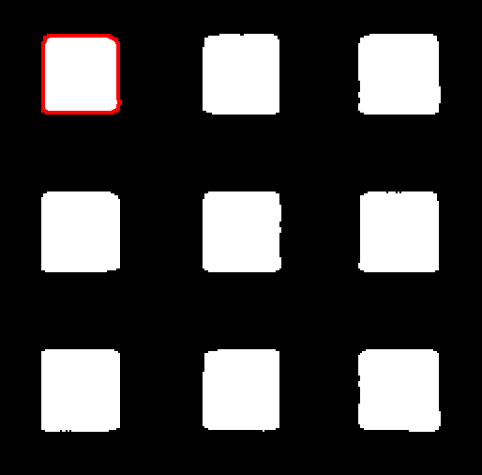
D. Contour detection and error-checking
Find contours of each pore on the grid mask
Check for square and even pore input on grid mask (eg: 8x8 pores, not 6x7 or 7x7)
Find contours of each pore on the binarized image set
Check for missing or split edges and mark them as invalid

Slide 23
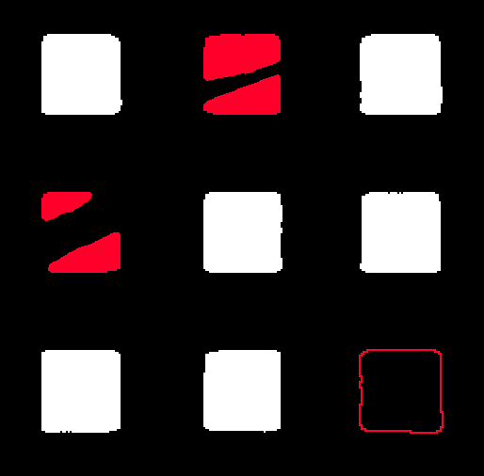
D. Contour detection and error-checking
Find contours of each pore on the grid mask
Check for square and even pore input on grid mask (eg: 8x8 pores, not 6x7 or 7x7)
Find contours of each pore on the binarized image set
Check for missing or split edges and mark them as invalid

Slide 24
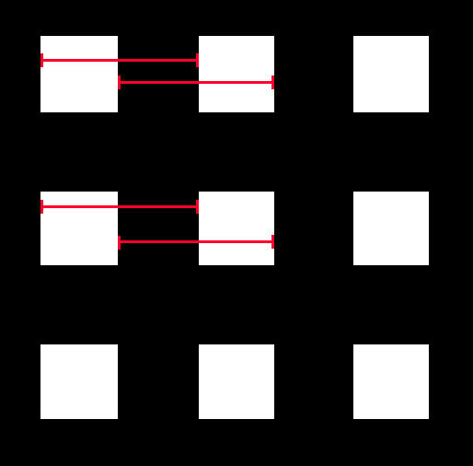
E. Pore information extraction
Get px/mm conversion factor
Obtain pore area and mark small pores as invalid
Extract pore perimeter
Calculate pore circularity and mark weird pores as invalid
Calculate pore size
Obtain pore distance
Mean distance of rising and falling edges of each pore with the following, on the grid mask

Slide 25
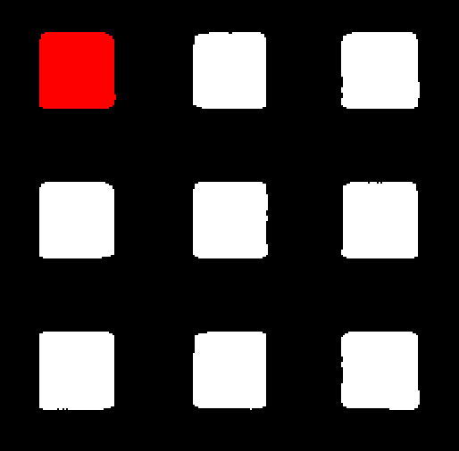
E. Pore information extraction
Get px/mm conversion factor
Obtain pore area and mark small pores as invalid
Extract pore perimeter
Calculate pore circularity and mark weird pores as invalid
Calculate pore size
Obtain pore distance
Small: area less than 0.09mm²

Slide 26
E. Pore information extraction
Get px/mm conversion factor
Obtain pore area and mark small pores as invalid
Extract pore perimeter
Calculate pore circularity and mark weird pores as invalid
Calculate pore size
Obtain pore distance

Slide 27
E. Pore information extraction
Get px/mm conversion factor
Obtain pore area and mark small pores as invalid
Extract pore perimeter
Calculate pore circularity and mark weird pores as invalid
Calculate pore size
Obtain pore distance
Perfect square circularity ≈ 0.785
Pore valid if circularity is within 8% of this value

Slide 28
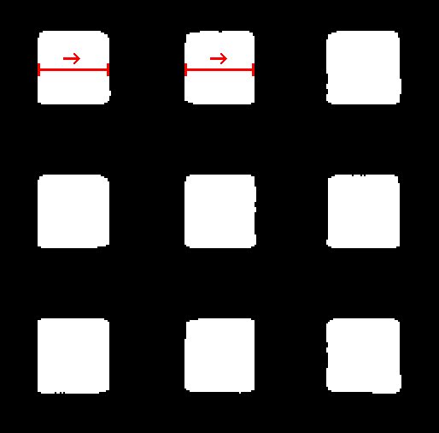
E. Pore information extraction
Get px/mm conversion factor
Obtain pore area and mark small pores as invalid
Extract pore perimeter
Calculate pore circularity and mark weird pores as invalid
Calculate pore size
Obtain pore distance
In the direction of printing. Pore size defined as difference between lowest 10th percentile contour position and highest 90th percentile

Slide 29
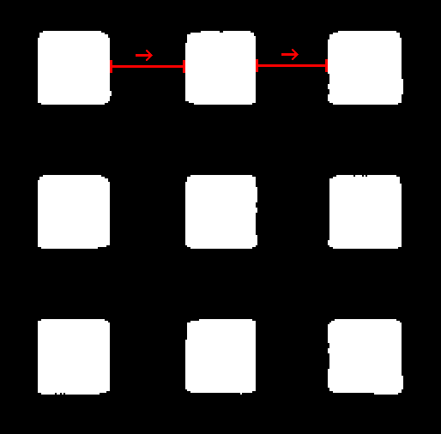
E. Pore information extraction
Get px/mm conversion factor
Obtain pore area and mark small pores as invalid
Extract pore perimeter
Calculate pore circularity and mark weird pores as invalid
Calculate pore size
Obtain pore distance
In the direction of printing. Pore distance defined as difference between highest 90th lowest percentile in current pore and lowest 10th percentile of next pore

